Slide 1


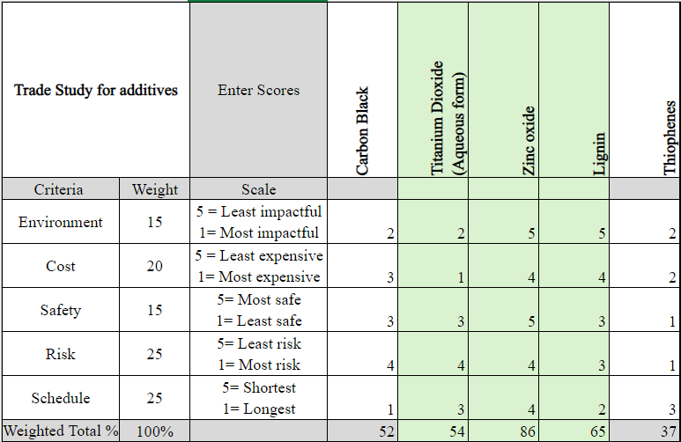
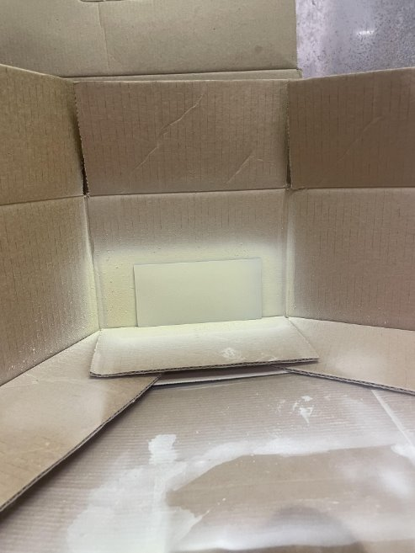
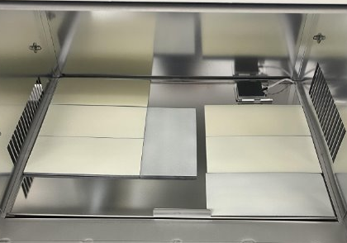
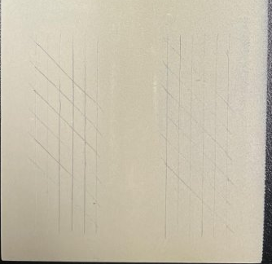
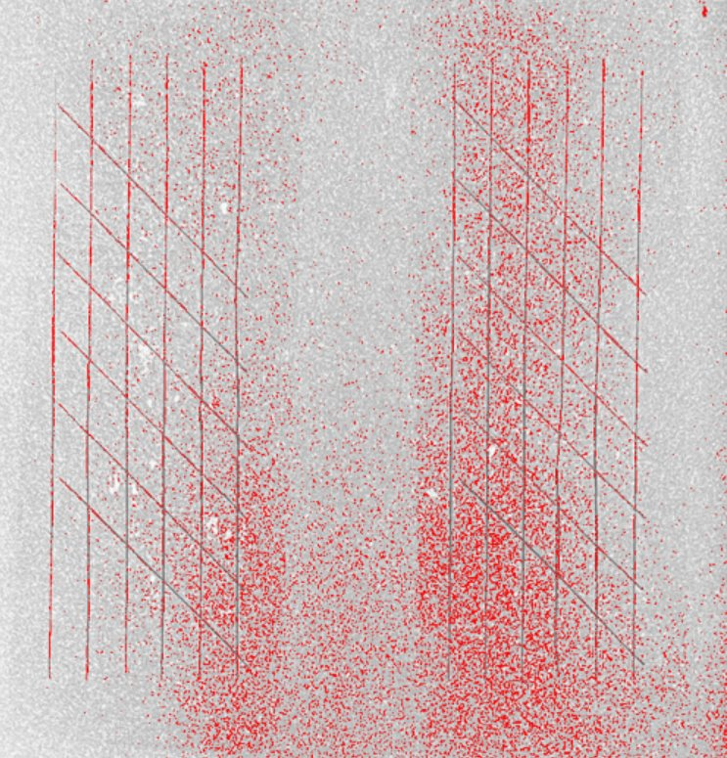
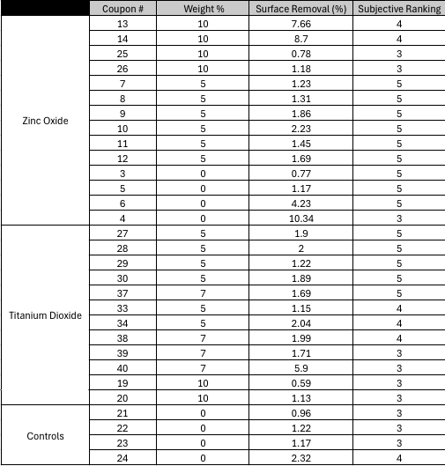
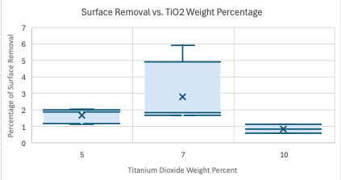
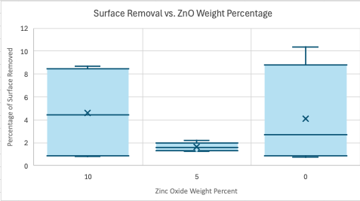
Coatings for Improved UV-Protection of Additively Manufactured Photopolymers
Alexa Jung, Garrett Wattawa, Susan Luu, Isaac Miller
Boeing Industry Mentors: Kjersta Larson-Smith, Angela Davis, Zach Renwick
Faculty Mentor: Ben Rutz
BACKGROUND
METHOD
Upon down selection of additives, coupon preparation was performed as follows:
> Coupons prepped by sanding, measuring thickness, coating, and curing
> Coupons exposed to UV in chamber for 2 weeks, rearranging midway
> Qualitative testing using cross hatch adhesion. Quantitative testing using ImageJ
> Adhesion was ranked using the ASTM classification. ImageJ gave % surface removal
CONCLUSIONS
Aerospace industry interested in AM
photopolymers:
>Lightweight
>Durable
>Environmentally friendly
Use limited by:
>Poor mechanical properties at elevated temperatures
>Flammability
Problem of interest:
Susceptibility to UV degradation
> Trade study analysis was completed to evaluate effectiveness and impact of each additive. Shown in Fig 1, Titanium Dioxide, Zinc Oxide, and Lignin were selected
5-10 wt. % zinc oxide is the most promising additive
Several limitations to this project
Due to spray coating issues and lack of agitation equipment, our team struggled to produce smooth, consistent coatings.
Recommend testing the accuracy of our results
Coupon Prep
UV Exposure
Coupon Testing
Data Analysis
PROPOSED SOLUTION
Design a sprayable paint coating that limits photopolymer's tendency to denature under constant UV exposure
SCOPE
Done within a 5-month planning/experimental period
$2000 budget
Test viability of designed multiple UV-protective paint coatings
  Zinc Oxide
  Titanium Oxide
  Controls
Future work:
> Experimental Validation:
Validate findings through further experimentation at Boeing using state-of-the-art equipment.
> Sustainability: Characterize the recycling properties of the additives for renewability.
> Expand testing: (1) Test other potential additives like carbon black and lignin, (2) implement longer UV exposure, and (3) utilize a chamber with a weathering function.
Fig 1. Trade study for down selection of additives
RESULTS
> Standard Adhesion rankings of 4 to 5 were the most commonly occurring ranking in both Zinc Oxide and Titanium Dioxide
> Variance in surface analysis is consistent across each additive highlighted in Figure 3.
ACKNOWLEDGEMENTS
We would like to thank our faculty mentor, Boeing industry mentors, and the Clean Energy Institute for their support throughout this project.
Fig 2. Net Testing Comparison between Titanium Dioxide, Zinc Oxide, and controls
Fig 3. Histogram Plots of Surface Removal per Weight Percentage

